Slide 1

A Crash Course in AWS Data Migration Service Joseph Fluckiger Tableau Software Presented at Agile Austin Aug 28th 2019

Slide 2
Does Data Migration Matter?

Slide 3

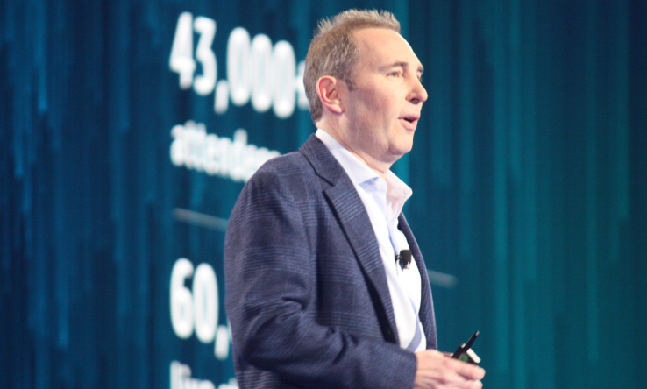

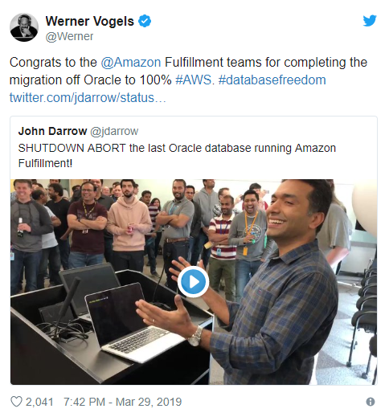
“It's kind of embarrassing" that Amazon still uses Oracle's databases to power its business.
- Larry Ellison, Aug 2018
In 2017 Amazon spent $60 Million on Oracle Products. Ellison trashed AWS in his keynote at the Oracle Cloud Conference.
In latest episode of "uh huh, keep talkin' Larry," Amazon’s Consumer business turned off its largest Oracle data warehouse on Nov 1st and moved to Redshift.
Andy Jassy, Nov 2018
Congrats to the Amazon Fulfillment teams for completing the migration off Oracle to 100% AWS.
- Werner Vogels, Mar 2019
Notes:
Heated Battle between Larry Ellison CEO of Oracle and Andy Jassie - AWS.
Story: When I was interviewing at AWS, asked if they had made good on the promise to migrate Amazon.com from Oracle to Postgres, and they indeed have. AWS definitely makes a lot of money from RDS, AWS migrated from Oracle to Postgres Aurora. This was a major priority in 2018, which was successfully completed
I’ll bet you this will be something that is highlighted at AWS ReInvent in December.

Slide 4




Hi, I’m Joseph Some of the Software I’ve worked on

Slide 5
What is DMS?

Slide 6
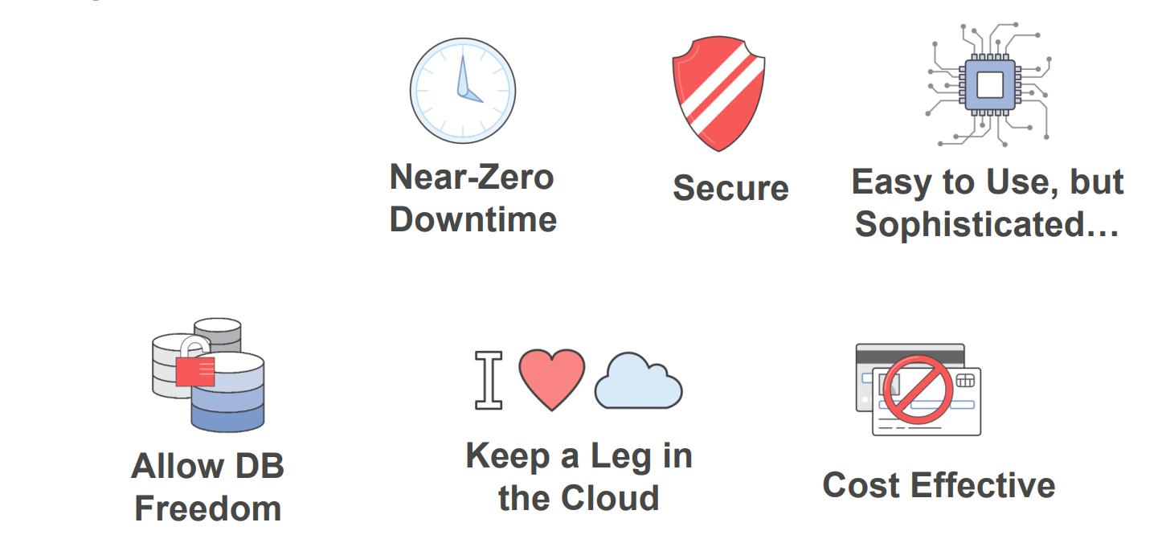

What is AWS Data Migration Service?

Slide 7
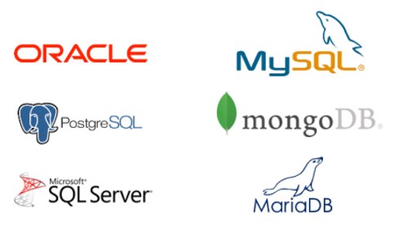
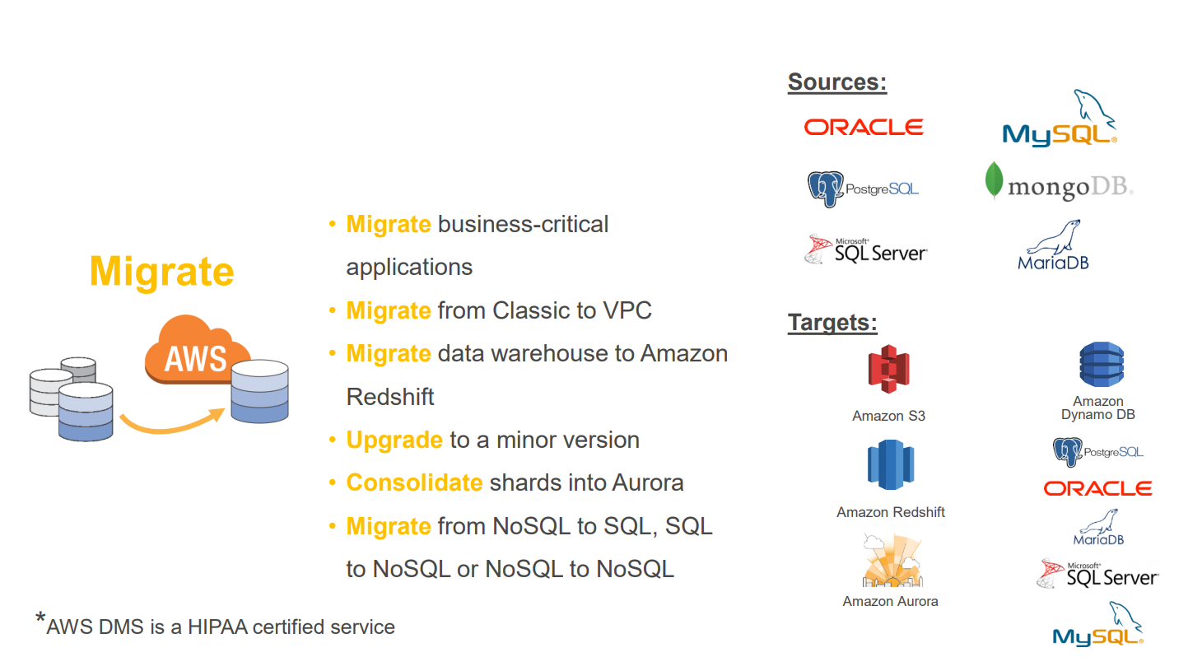
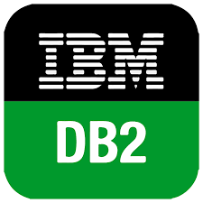
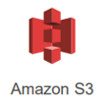
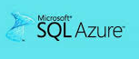

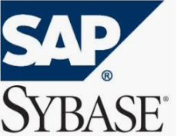


Supported Data Endpoints
Sources
Targets
Notes:
Note what is missing from the Targets? Why would some databases not be listed in Targets?
You can tell the age of the database by the logo

Slide 8
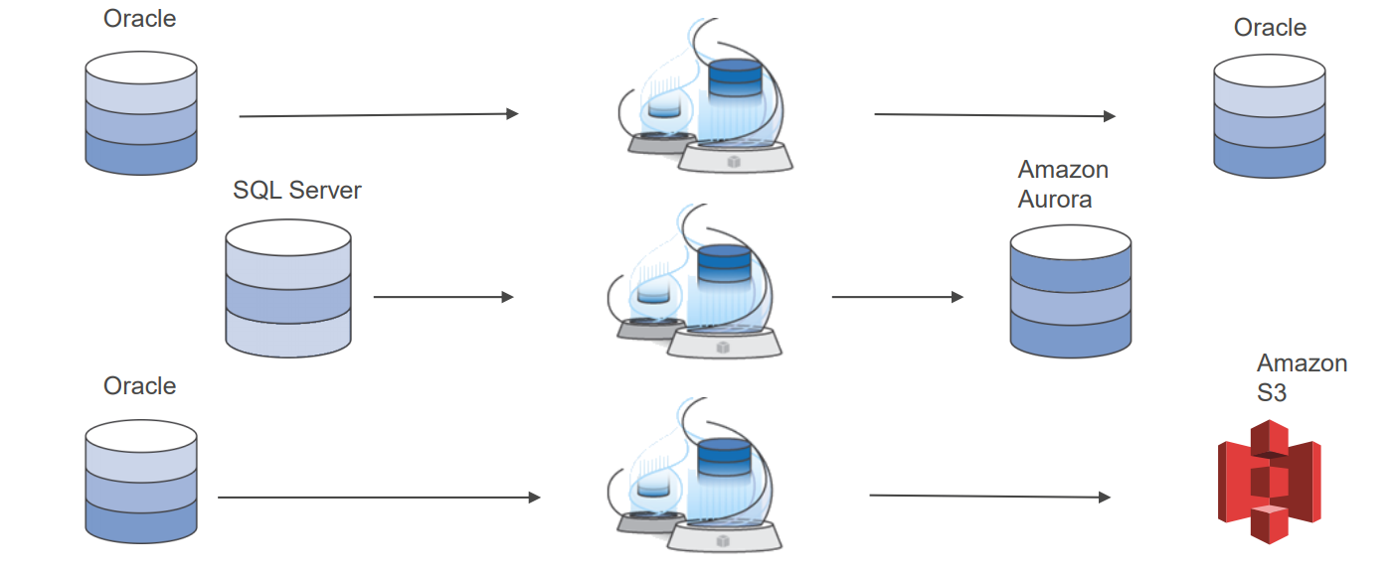
Homogeneous and Heterogeneous Migration

Slide 9
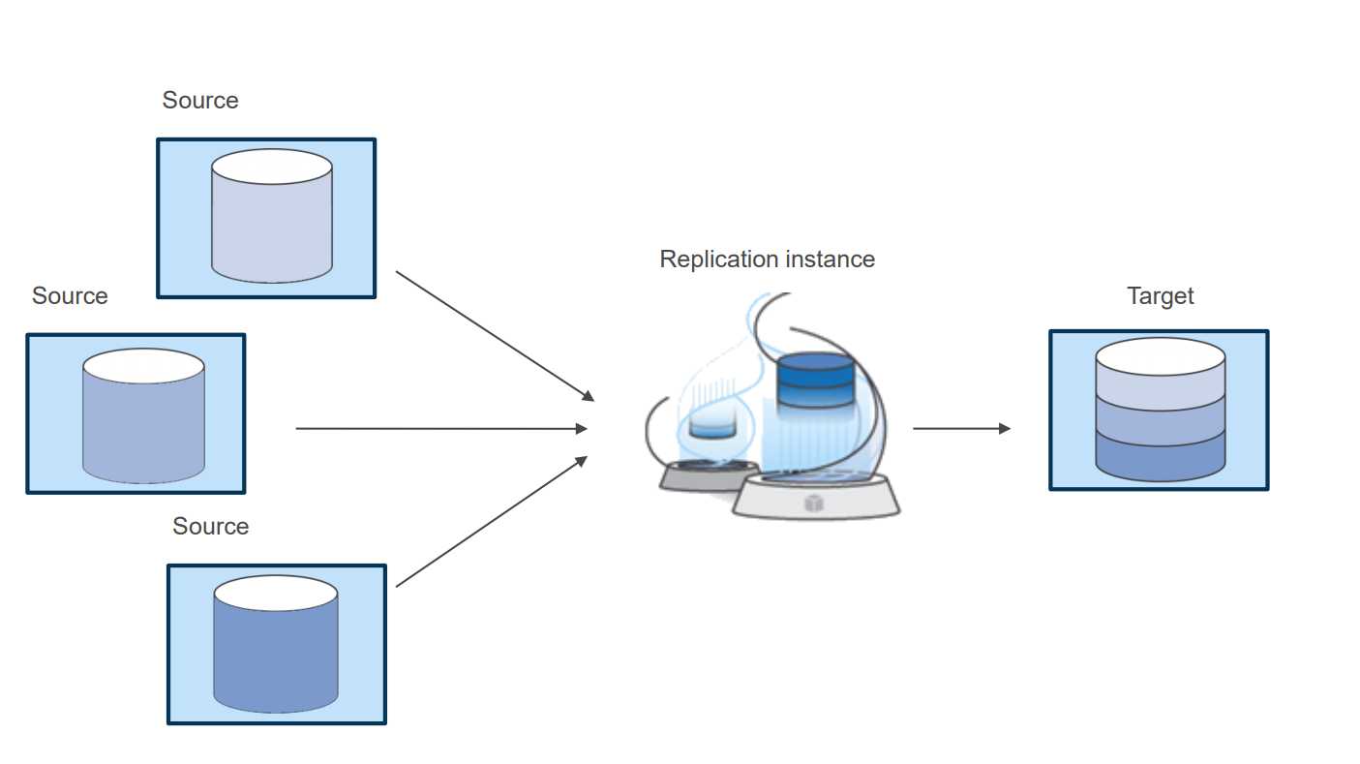
Consolidate databases onto a single server
Notes:
Additional reasons:
- Modernize
- License Fees.
With our migration for example, we reduced cost from $7000 to $500 per month MS Sql Enterprise license – Aurora Postgres, QA database used for intermittent load testing

Slide 10
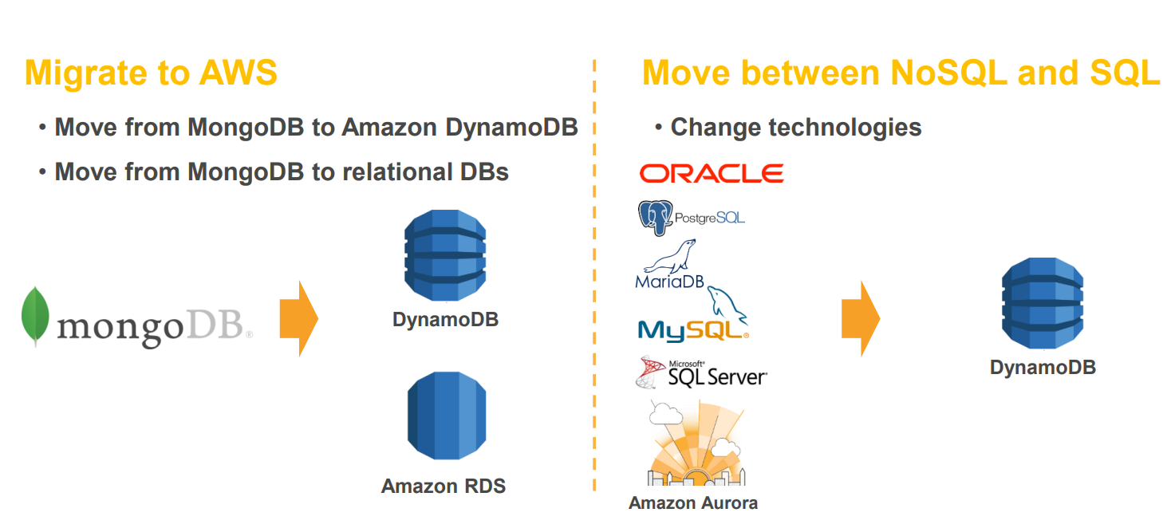
Migrate from NoSql to Sql database

Slide 11
How

Slide 12
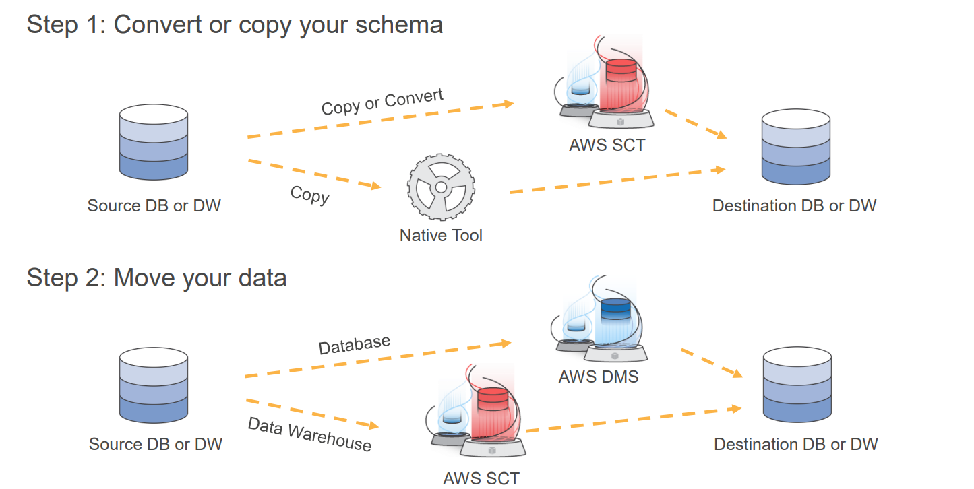
Steps To Migrate
Notes:
DMS will by default only create the primary indexes and migrate the data,
It will not create:
secondary indexes
unique indexes
stored procedures
user defined fields
data defaults
For Homogeneous migration do a no-data schema script of your database.
For Heterogeneous migration use SCT

Slide 13
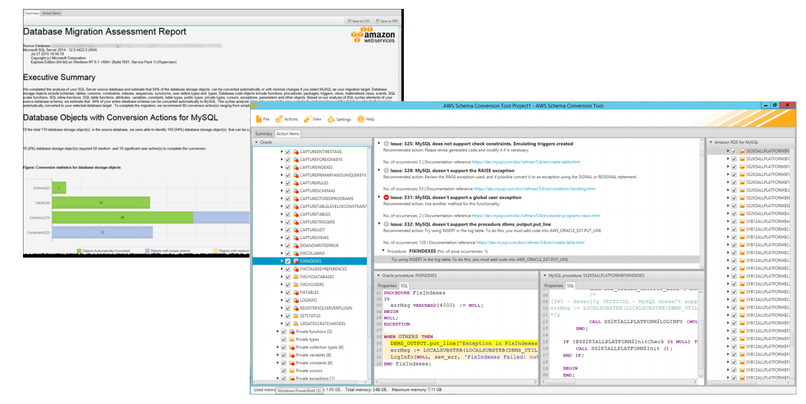
Schema Conversion Tool

Slide 14
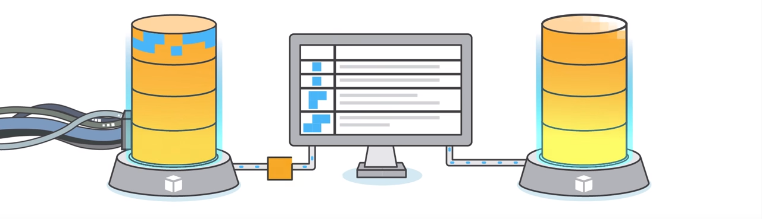
Migrate without Downtime
Perform a Full DMS migration
After full migration is complete any transactions will be replicated to the target
Shut down your applications
Allow any remaining transactions to be applied to the target
Restart your applications pointing at the new target database

Slide 15
3 Migration Types
Migrate Existing Data
When you can afford an outage that’s long enough to copy the whole database
Migrate Existing Data and replicate Ongoing Changes
Full migration with DMS + Replicate changes with DMS
Replicate data changes only
Full migration without DMS + Replicate changes with DMS
Notes:
LOB mode – ability to migrate or not migrate LOBs (Large Objects)
Enable Logging – Written to Cloudwatch

Slide 16
Migration Performance
Resource Availability on Source and Target
Network performance
Replication Server
Type of Data
Amount of Data
1 Terabyte of data migrated in 12 hours between two AWS RDS databases
Notes:
During the migration, try to remove any processes that would compete for write resources on your target database.
disabling unnecessary triggers, validation, secondary indexes, and so on.
When migrating to an RDS database, it’s a good idea to disable backups and Multi-AZ on the target until you’re ready to cutover.
Similarly, when migrating to non-RDS systems, disabling any logging on the target until cutover is usually a good idea.
How much load is placed on the Source database?
It depends,
During a migration, AWS DMS performs a full table scan of the source table for each table processed in parallel. Additionally, each task periodically queries the source for change information.

Slide 17


Customers Using DMS

Slide 18
Cost

Slide 19
Cost
DMS is free for six months when migrating to Migrating to Amazon Aurora, Redshift, DynamoDB or Amazon DocumentDB
Otherwise cost is based on EC2 pricing only while the data migration Task is running. (Replication instance automatically stops after task is finished)
Data transfer is free into DMS
Data transfer is free from DMS to an RDS in the same availability zone
If you need more than 500 GB for log storage, price is $0.115 GB/month
Notes:
DMS pricing https://aws.amazon.com/dms/pricing/?nc=sn&loc=3
With our migration for example, we reduced cost from $7000 to $500 per month MS Sql Enterprise license – Aurora Postgres, QA database used for intermittent load testing

Slide 20
Cost Example
Replication instance pricing example
c4.4xlarge Price = $1.24 /hr
Multi-AZ (x2 instances)
A tasks that runs for 12 hours
$1.24 x 2 x 12 = $29.6
Notes:
DMS pricing https://aws.amazon.com/dms/pricing/?nc=sn&loc=3

Slide 21
Alternatives

Slide 22
Alternative - Native Backup/Restore
If you’re not switching engines and can take downtime:
SQL Server: bak file import
MySQL: read replicas
AWS RDS backup to S3 and Restore
Oracle SQL Developer, Data Pump, Export/Import
PostgreSQL: pg_dump
SAP ASE: bcp

Slide 23
Alternative – Enterprise migration services
LICENSED
Informix by IBM
Rainfinith by EMC
Data Integrator by Centerprise
InfoSphere by IBM
PowerCenter by Informatica
Microsoft SQL SSIS
Oracle Data Service Integrator
Talend Data Integration
Configero for Salesforce
Data Migration Manager by Brodcade
Universal Replicator by Hitachi
Apex Data Loader by Salesforce
OPEN SOURCE
Data Pull by VBRO
Rsync
Apache NiFi
CloverETL
Myddleware
Pentaho
CloverETL
Pentaho
Talend Open Studio
CLOUD
Alooma
Fivetran
Matillion
Snaplogic
Stitch Data
Notes:
Source: https://www.alooma.com/blog/data-migration-tools/
https://www.softwaretestinghelp.com/data-migration-tools/

Slide 24
Best Practices

Slide 25
Best Practices
For high availability scenarios deploy DMS as Multi-AZ
Experiment with instance types and number of tasks per instance
Create target tables manually (Gives you fine grain control over schema and index creation.) Or use SMT.
One task per one table (provides the most flexibility when applying custom filters, etc)
Use an AWS CLI when creating many tasks
Write your own Script to compare tables in source and target database

Slide 26
Demo
Notes:
Show console
Show Python Script

Slide 27
AWS DMS Resources
Launch announcement at AWS Reinvent link
High Level Introduction to DMS link
Best Practices link
Documentation on the Python API for DMS link

